Slide 1
Graphing Practice

Slide 2
Quick review
What is Data?
Information gathered about the real world
Commonly referred to as statistics
Helps to classify and quantify the world.
Two types- categorical and numerical
What are graphs?
Graphs are used to display data in easy to read formats
Many different graph formats, including pie, pictograph, line, column, and bar.

Slide 3
24
7
30
Date: 29/5/2018
Topic : Graphs
EQ – What is a clustered column graph?
A clustered column graph is used to demonstrate two different groups of results to the same question.
Columns are constructed next to each other above the same category- this makes it easy to compare.
Lets practise making a graph. A recent survey of 50 boys and 50 girls was conducted to determine their favourite car manufacturer from the brand listed. The results are listed below.
Car brand | Boys | Girls
Toyota | 8 | 18
Ford | 22 | 13
Subaru | 10 | 9
Nissan | 10 | 10
Total | 50 | 50

Slide 4
How does it look?
Looking at the graph, what can we see?
Does our graph have all of the require features to be an informative graph?

Slide 5
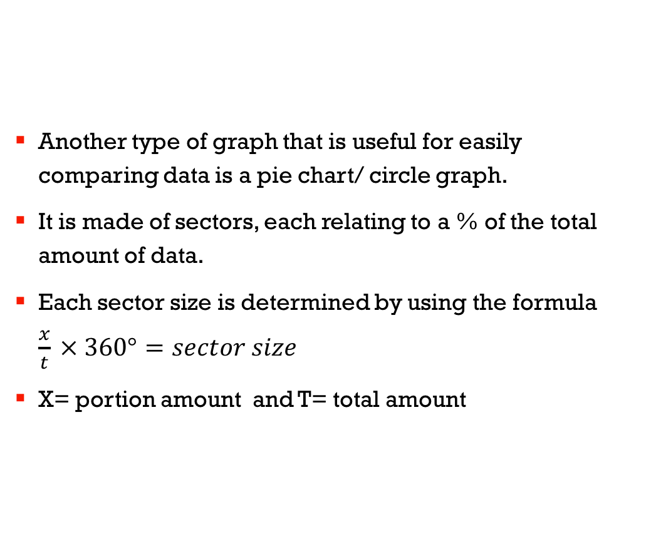
Other comparison graphs- 3.14(pi)
Another type of graph that is useful for easily comparing data is a pie chart/ circle graph.
It is made of sectors, each relating to a % of the total amount of data.
Each sector size is determined by using the formula $\frac{x}{t} × 360°=sector size$
X= portion amount and T= total amount

Slide 6
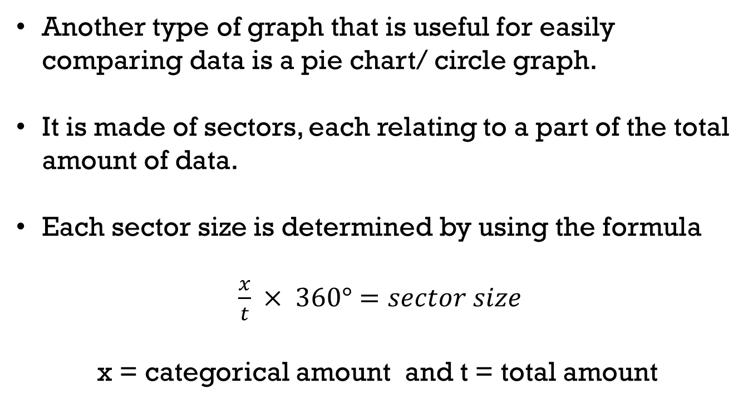
24
7
30
Date: 29/5/2018
Topic : Graphs
EQ – What is a Pie graph?
Another type of graph that is useful for easily comparing data is a pie chart/ circle graph.
It is made of sectors, each relating to a part of the total amount of data.
Each sector size is determined by using the formula
$\frac{x}{t} × 360°=sector size$
x = categorical amount and t = total amount

Slide 7

24
7
30
Date: 29/5/2018
Topic : Graphs
EQ – What is a Pie graph?
Pie graphs or pie charts are often used in budgeting/ finances. Using the table below, lets work out how many degrees each sector would be.
Fill in the sector size below
$$\frac{x}{t} × 360°=sector size$$
Spending | Amount ($) [x] | Sector size (º)
Rent | 400.00
Car running cost | 150.00
Savings | 350.00
Clothing | 100.00
Total | $1000.00 [t]
Sector size (º)
400/1000x360 = 144º
150/1000x360 = 54º
350/1000x360 = 126º
100/1000x360 = 36º
144+54+126+36 = 360º

Slide 8
Pie Chart
Putting it together:
Making a pie chart, we use the sector size and divide a circle into the degree amounts.
TIP- If the degree amounts do not come out as whole numbers, check your rounding. You may end up with too many or too few degrees.

Slide 9
24
7
30
Date: 29/5/2018
Topic : Graphs
EQ – What is a spreadsheet?
Spreadsheets are used to track spending's and income across multiple months and years.
Lets look at a spreadsheet example and see how it can be used long-term.

Slide 10
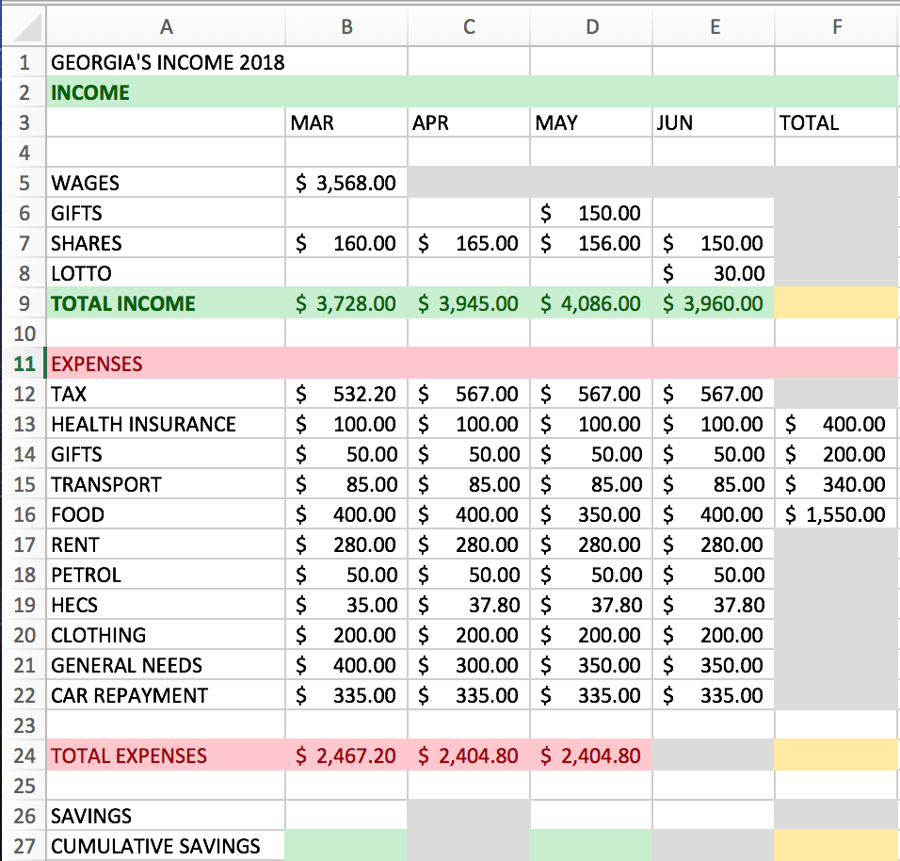
Georgia’s Budget is listed left.
Using the information presented;
Fill in the grey squares with the missing values
Answer the following:
How much did her savings increase by?
What Percentage of her total income was spent?
Which month did she spend the largest proportion of her income?
Which month had the lowest percentage of spending?
Using this information, construct a pie chart for the month of May.

Slide 11
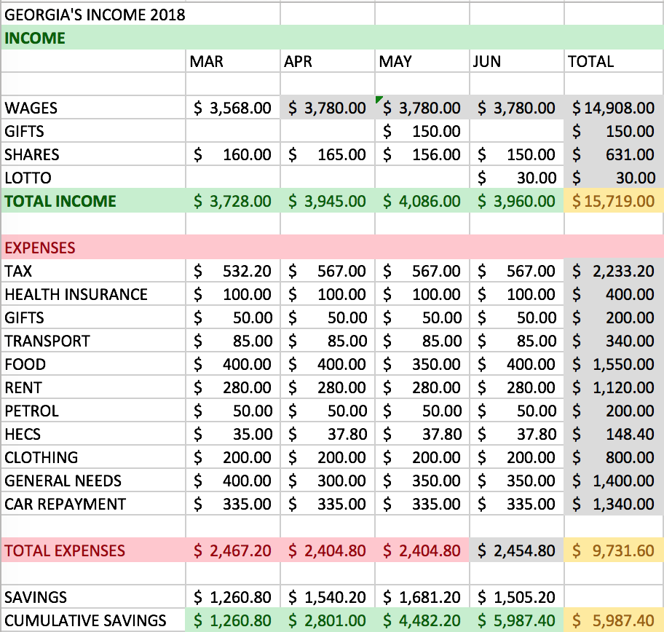
Below is the spreadsheet filled in, and an example of the pie chart.

